Slide 1
Agenda
Start | End | Item
 |  | Regression in Action
 |  | Partitioning Data
 |  | Understanding Regression (simple univariate)
 |  | Build & Evaluate a Multiple Linear Regression
 |  | Logistic Regression for Classification

Slide 2
Review
Day 1 – Basics of data mining including structure of a business problem.
Day 2 – R environment, some basic Exploratory Data Analysis, visuals, maps
Day 3- Revision: Preparing your data for modeling using library(vtreat)
Day 3- Regressions/Logistic Regression - abridged

Slide 3
Data Structure for Analysis & Modeling
Target, Y, or Dependent Variable
Identifier
Informative Features or predictors
name | mfr | type | calories | protein | fat | sodium | fiber | carbo | sugars | potass | vitamins | shelf | weight | cups | rating
100%_Bran | N | C | 70 | 4 | 1 | 130 | 10 | 5 | 6 | 280 | 25 | 3 | 1 | 0.33 | 68.40297
100%_Natural_Bran | Q | C | 120 | 3 | 5 | 15 | 2 | 8 | 8 | 135 | 0 | 3 | 1 | 1 | 33.98368
All-Bran | K | C | 70 | 4 | 1 | 260 | 9 | 7 | 5 | 320 | 25 | 3 | 1 | 0.33 | 59.42551
All-Bran_with_Extra_Fiber | K | C | 50 | 4 | 0 | 140 | 14 | 8 | 0 | 330 | 25 | 3 | 1 | 0.5 | 93.70491
Almond_Delight | R | C | 110 | 2 | 2 | 200 | 1 | 14 | 8 |  | 25 | 3 | 1 | 0.75 | 34.38484
Apple_Cinnamon_Cheerios | G | C | 110 | 2 | 2 | 180 | 1.5 | 10.5 | 10 | 70 | 25 | 1 | 1 | 0.75 | 29.50954
Apple_Jacks | K | C | 110 | 2 | 0 | 125 | 1 | 11 | 14 | 30 | 25 | 2 | 1 | 1 | 33.17409
Basic_4 | G | C | 130 | 3 | 2 | 210 | 2 | 18 | 8 | 100 | 25 | 3 | 1.33 | 0.75 | 37.03856
Bran_Chex | R | C | 90 | 2 | 1 | 200 | 4 | 15 | 6 | 125 | 25 | 1 | 1 | 0.67 | 49.12025
Bran_Flakes | P | C | 90 | 3 | 0 | 210 | 5 | 13 | 5 | 190 | 25 | 3 | 1 | 0.67 | 53.31381
Cap'n'Crunch | Q | C | 120 | 1 | 2 | 220 | 0 | 12 | 12 | 35 | 25 | 2 | 1 | 0.75 | 18.04285
Generally we will use data frames to avoid complexity but you will be exposed to other data types.

Slide 4
Dummy Variables
Dummy Variables represent category levels as 1/0 within new vectors. For some approaches, this lets the algorithm understand the information.
Consider this data:
Through EDA you realize:
CuID | Gender | Profession | Affiliation
CU43E439 | Male | Nurse | Democrat
CU36E506 | Male | Teacher | Independent
CU91E65 | Female | Manager | Republican
CU17E255 | Male | Student | Democrat
CU27E792 | Female | Executive
CU74E430 | Female | Manager | Republican
CU25E466 | Female | Teacher | Democrat
You wouldn’t use the ID var for training
Gender has 2 levels
Profession has 5 levels
Affiliation has 3 levels & missing

Slide 5
Dummy Variables
Always make dummy variables “1 less than the state of the data nature”
Consider this data:
CuID | Gender | Profession | Affiliation
CU43E439 | Male | Nurse | Democrat
CU36E506 | Male | Teacher | Independent
CU91E65 | Female | Manager | Republican
CU17E255 | Male | Student | Democrat
CU27E792 | Female | Executive
CU74E430 | Female | Manager | Republican
CU25E466 | Female | Teacher | Democrat
CuID | Gender__Male | Profession_Nurse | Profession_Teacher | Profession_Manager | Profession_Student | Affiliation_D | Affiliation_I | Affiliation_Missing
CU43E439 | 1 | 1 | 0 | 0 | 0 | 1 | 0 | 0
CU36E506 | 1 | 0 | 1 | 0 | 0 | 0 | 1 | 0
CU91E65 | 0 | 0 | 0 | 1 | 0 | 0 | 0 | 0
CU17E255 | 1 | 0 | 0 | 0 | 1 | 1 | 0 | 0
CU27E792 | 0 | 0 | 0 | 0 | 0 | 0 | 0 | 1
CU74E430 | 0 | 0 | 0 | 1 | 0 | 0 | 0 | 0
CU25E466 | 0 | 0 | 1 | 0 | 0 | 1 | 0 | 0
A light switch has 2 states, on/off. You only need 1 switch. The same is true as more levels are added, you don’t need one for each level.
Notes:
Multicolinearity – counting things twice, algo understands all 0’s represents a piece of information.
Missing “flag” - often has a hidden meaning such as data integrity or data collection. Sometimes these issues are systematic & informative

Slide 6
Numeric Variables
Numeric variables need to be examined, corrected and missing flags need to be created.
Consider this data:
With domain expertise you realize:
Model | mpg | cyl | disp | hp | drat | wt | qsec
Mazda RX4 | 21 | 6 | 160 | 110 | 3.9 | 2.62
Mazda RX4 Wag | 21 | 6 | 160 | -110 | 3.9 | 2.875 | 17.02
Datsun 710 | 122.8 | NA | 108 | 93 | 3.85 | 2.32 | 18.61
Hornet 4 Drive | 21.4 | 6 | 258 | 110 | 3.08 | 3.215 | 19.44
Hornet Sportabout | 18.7 | 8 | ? | 175 | 3.15 | 3.44 | 17.02
Valiant | 18.1 | 6 | 225 | 105 | 2.76 | NA | 20.22
Duster 360 | 14.3 | 8 | 360 | 245 | 3.21 | 3.57 | 15.84
Merc 240D | 24.4 | 4 | 146.7 | 62 | 3.69 | 3.19
Merc 230 | 22.8 | 4 | 140.8 | 95 | 3.92 | 3.15 | 22.9
Merc 280 | 19.2 | 6 | 167.6 | 123 | 3.92 | 3.44 | 18.3
Its unlikely a car has 122mpg
No way -110 horsepower!
Through EDA you realize:
Missing values are blank, NA, and “?”

Slide 7
Outlier Numeric Variables
Outliers can be removed or the values can be replaced with imputation.
Consider this data:
Drop a row if:
You have many other records for training
The record contains multiple integrity issues
Model | mpg | cyl | disp | hp | drat | wt | qsec
Mazda RX4 | 21 | 6 | 160 | 110 | 3.9 | 2.62
Mazda RX4 Wag | 21 | 6 | 160 | -110 | 3.9 | 2.875 | 17.02
Datsun 710 | 122.8 | NA | 108 | 93 | 3.85 | 2.32 | 18.61
Hornet 4 Drive | 21.4 | 6 | 258 | 110 | 3.08 | 3.215 | 19.44
Hornet Sportabout | 18.7 | 8 | ? | 175 | 3.15 | 3.44 | 17.02
Valiant | 18.1 | 6 | 225 | 105 | 2.76 | NA | 20.22
Duster 360 | 14.3 | 8 | 360 | 245 | 3.21 | 3.57 | 15.84
Merc 240D | 24.4 | 4 | 146.7 | 62 | 3.69 | 3.19
Merc 230 | 22.8 | 4 | 140.8 | 95 | 3.92 | 3.15 | 22.9
Merc 280 | 19.2 | 6 | 167.6 | 123 | 3.92 | 3.44 | 18.3
Impute (use a method to change the value):
Hotdeck – choose a random value in the vector say 19.2
Mean Imputation – mean avg of vector
Median Imputation – median avg
Train an algorithm to fill in the values (KNN)
Notes:
Document document document!!

Slide 8
Missing Numeric Variables
Imputation is a best practice over Usually start with an easy method like median or hotdeck.
Consider this data:
Drop a row if:
You have many other records for training
The record contains multiple integrity issues
Model | mpg | cyl | disp | hp | drat | wt | qsec
Mazda RX4 | 21 | 6 | 160 | 110 | 3.9 | 2.62
Mazda RX4 Wag | 21 | 6 | 160 | -110 | 3.9 | 2.875 | 17.02
Datsun 710 | 20.1 | NA | 108 | 93 | 3.85 | 2.32 | 18.61
Hornet 4 Drive | 21.4 | 6 | 258 | 110 | 3.08 | 3.215 | 19.44
Hornet Sportabout | 18.7 | 8 | ? | 175 | 3.15 | 3.44 | 17.02
Valiant | 18.1 | 6 | 225 | 105 | 2.76 | NA | 20.22
Duster 360 | 14.3 | 8 | 360 | 245 | 3.21 | 3.57 | 15.84
Merc 240D | 24.4 | 4 | 146.7 | 62 | 3.69 | 3.19
Merc 230 | 22.8 | 4 | 140.8 | 95 | 3.92 | 3.15 | 22.9
Merc 280 | 19.2 | 6 | 167.6 | 123 | 3.92 | 3.44 | 18.3
Impute (use a method to change the value):
Hotdeck
Mean
Median
Algorithm (KNN)
Notes:
Changed mpg to mean avg
Document document document
add flag

Slide 9
Missing Numeric Variables
Imputation through domain expertise can be VERY time consuming but is sometimes worth it though not often.
Consider this data:
Drop a row if:
You have many other records for training
The record contains multiple integrity issues
Model | mpg | cyl | disp | hp | drat | wt | qsec
Mazda RX4 | 21 | 6 | 160 | 110 | 3.9 | 2.62
Mazda RX4 Wag | 21 | 6 | 160 | -110 | 3.9 | 2.875 | 17.02
Datsun 710 | 20.1 | 8 | 108 | 93 | 3.85 | 2.32 | 18.61
Hornet 4 Drive | 21.4 | 6 | 258 | 110 | 3.08 | 3.215 | 19.44
Hornet Sportabout | 18.7 | 8 | 146.7 | 175 | 3.15 | 3.44 | 17.02
Valiant | 18.1 | 6 | 225 | 105 | 2.76 | 3.15 | 20.22
Duster 360 | 14.3 | 8 | 360 | 245 | 3.21 | 3.57 | 15.84
Merc 240D | 24.4 | 4 | 146.7 | 62 | 3.69 | 3.19
Merc 230 | 22.8 | 4 | 140.8 | 95 | 3.92 | 3.15 | 22.9
Merc 280 | 19.2 | 6 | 167.6 | 123 | 3.92 | 3.44 | 18.3
Impute (use a method to change the value):
-110 looks like a data entry issue & other Mazda has 110.
Qsec can be imputed with the similar model values.
Notes:
Hotdeck for disp hp and wt
Document document document
add flag

Slide 10
Missing Numeric Variables
Imputation through domain expertise can be VERY time consuming but is sometimes worth it though not often.
Consider this data:
Drop a row if:
You have many other records for training
The record contains multiple integrity issues
Model | mpg | cyl | disp | hp | drat | wt | qsec
Mazda RX4 | 21 | 6 | 160 | 110 | 3.9 | 2.62 | 17.02
Mazda RX4 Wag | 21 | 6 | 160 | 110 | 3.9 | 2.875 | 17.02
Datsun 710 | 20.1 | 8 | 108 | 93 | 3.85 | 2.32 | 18.61
Hornet 4 Drive | 21.4 | 6 | 258 | 110 | 3.08 | 3.215 | 19.44
Hornet Sportabout | 18.7 | 8 | 146.7 | 175 | 3.15 | 3.44 | 17.02
Valiant | 18.1 | 6 | 225 | 105 | 2.76 | 3.15 | 20.22
Duster 360 | 14.3 | 8 | 360 | 245 | 3.21 | 3.57 | 15.84
Merc 240D | 24.4 | 4 | 146.7 | 62 | 3.69 | 3.19 | 22.9
Merc 230 | 22.8 | 4 | 140.8 | 95 | 3.92 | 3.15 | 22.9
Merc 280 | 19.2 | 6 | 167.6 | 123 | 3.92 | 3.44 | 18.3
Impute (use a method to change the value):
-110 looks like a data entry issue & other Mazda has 110.
Qsec can be imputed with the similar model values.
Notes:
Hotdeck for disp hp and wt
Document document document
add flag

Slide 11
Missing Flags
Add missing indicator dummy variables similar to the categorical exercise.
Consider this data:
Model | mpg | cyl | disp | hp | drat | wt | qsec | missingMPG | missingDisp | missingHP | missingWT | missingQSec
Mazda RX4 | 21 | 6 | 160 | 110 | 3.9 | 2.62 | 17.02 | 0 | 0 | 0 | 0 | 1
Mazda RX4 Wag | 21 | 6 | 160 | 110 | 3.9 | 2.875 | 17.02 | 0 | 0 | 1 | 0 | 0
Datsun 710 | 20.1 | 8 | 108 | 93 | 3.85 | 2.32 | 18.61 | 1 | 0 | 0 | 0 | 0
Hornet 4 Drive | 21.4 | 6 | 258 | 110 | 3.08 | 3.215 | 19.44 | 0 | 0 | 0 | 0 | 0
Hornet Sportabout | 18.7 | 8 | 146.7 | 175 | 3.15 | 3.44 | 17.02 | 0 | 1 | 0 | 0 | 0
Valiant | 18.1 | 6 | 225 | 105 | 2.76 | 3.15 | 20.22 | 0 | 0 | 0 | 1 | 0
Duster 360 | 14.3 | 8 | 360 | 245 | 3.21 | 3.57 | 15.84 | 0 | 0 | 0 | 0 | 0
Merc 240D | 24.4 | 4 | 146.7 | 62 | 3.69 | 3.19 | 22.9 | 0 | 0 | 0 | 0 | 1
Merc 230 | 22.8 | 4 | 140.8 | 95 | 3.92 | 3.15 | 22.9 | 0 | 0 | 0 | 0 | 0
Merc 280 | 19.2 | 6 | 167.6 | 123 | 3.92 | 3.44 | 18.3 | 0 | 0 | 0 | 0 | 0
Notes:
Hotdeck for disp hp and wt
Document document document
add flag

Slide 12
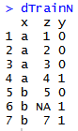
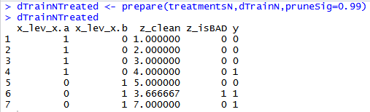
lib(vtreat) – automated variable treatment
Vtreat Actions | Common Name
NA, NAN, and Infinity replaced with mean | Mean imputation
Indicator | Missing indicator
Indicator variables | Dummy variable
Estimated single-variable model effect sizes and significances. | Mean response encoding or level difference from mean response based on univariate linear model for numeric & Bayes for classification
Level prevalence | Frequency encoding
Level deviation | Response deviation level encoding
Constant/Near Constant | Suppress uninformative variables
Raw Data
Design Treatment Plan
Prepare Data to get New Data Frame
treatmentsN <- designTreatmentsN(...)
Notes:
Automates a lot what we talked about, and some of the books code
easy, automated
Repeatable bc plan is saved
Dangerous bc automation can lead to probs (multi-colinarity) measuring things twice

Slide 13

Meet Donor Bureau

Slide 14
Let’s Practice
Open C_DataPreProcessingEngineering:
Variable | Description
rowID | Appended Row ID - noninformative
uniqueID | Unique Identifier – noninformative
Zip | Zip code group to anonymize
Homeowner | Y/N if they own a hom
NUMCHLD | Number of children in house
Income | Household Income
Gender | M/F
Wealth | Wealth rating uses median family income and population statistics from each area to index relative wealth within each state. The segments are denoted 0-9, with 9 being the highest wealth group and zero being the lowest. Each rating has a different meaning within each state.
Variable | Description
HV | Avg Home Value in potential donor's neighborhood in hundreds of dollars.
Icmed | Median Income in potential donor's neighborhood in hundreds of dollars.
Icavg | Avg Family Income in potential donor's neighborhood in hundreds of dollars.
IC15 | % earning less than $15K in potential donor's neighborhood.
NUMPROM | Lifetime # of promotions received to date
RAMNTALL | Dollar amount of lifetime gifts to date.
MAXRAMNT | Dollar amount of largest gift to date.
LASTGIFT | Dollar amount of most recent gift.
TOTALMONTHS | Number of months from last donation
TIMELAG | Number of months between first and second gift.
AVGGIFT | Average dollar amount of gifts to date.
Y1_Donation | Y/N did they donate
Y2_DonatedAmt | Dollar Amt of donation
Notes:
2 identifier col
2 y binary and continuous

Slide 15
Modeling Process
SEMMA (from SAS)
In this course…
1. Sample
In this course, most data sets are curated for you.
2. Explore
As part of your course analysis you perform basic exploratory data analysis (EDA)
3. Modify
Data cleanup, Dimension Reduction, Feature Engineering & Feature Enrichment
4. Model
Regression, Logistic Regression, KNN, Decision Trees, Random Forest etc.
5. Assess
There are many ways to evaluate a model. We will cover specific KPI and business implications.
Often data is sampled from a large database so you can more quickly explore, apply methods and prototype before reassessing on full data.

Slide 16
Steps in Data Mining (from the book)
Define/understand purpose
Obtain data (may involve random sampling)
Explore, clean, pre-process data
Reduce the data; if supervised DM, partition it
Specify task (classification, clustering, etc.)
Choose the techniques (regression, CART, neural networks, etc.)
Iterative implementation and “tuning”
Assess results – compare models
Deploy best model

Slide 17

What is a model?
An model is a set of rules governing actions or phenomena.
Empirical models
No Math:
Algo#1: “fur” =Y, “tail”=Y, “claws”=Y, “meow”=Y therefore high probability that’s a cat
Algo#2: “another meme”=Y, “short & bald professor”=Y therefore “professor trying to hard to be cool”
Machine learning (math based):
Algorithm (regression, KNN, Trees) is the method to have a computer understand a complex data structure
Regardless of type, all models can be correct or lead you to incorrect assumptions.

Slide 18
Vocabulary
What is a model?
What is an algorithm?
A set of rules governing actions, or describing phenomena.
Some representation of reality.
The method you choose to construct the model rules.
The way you expect to learn about reality.
The algorithm produces the model.

Slide 19
Agenda
Start | End | Item
 |  | Regression in Action
 |  | Partitioning Data
 |  | Understanding Regression (simple univariate)
 |  | Build & Evaluate a Multiple Linear Regression
 |  | Logistic Regression for Classification

Slide 20
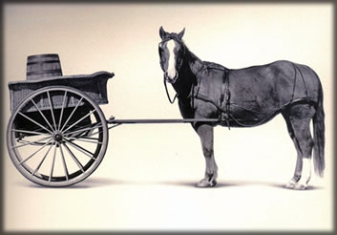
Let’s Practice
Open A_Regression.R
Predict Diamond Prices with linear regression.

Slide 21
Agenda
Start | End | Item
 |  | Regression in Action
 |  | Partitioning Data
 |  | Understanding Regression (simple univariate)
 |  | Build & Evaluate a Multiple Linear Regression
 |  | Logistic Regression for Classification

Slide 22
The problem of Overfitting
Statistical models can produce highly complex explanations of relationships between variables
The “fit” may be excellent
Beware of models that look perfect. Deployed model will not work as well as expected with completely new data.
Notes:
22

Slide 23
Minimize Overfitting - Partitioning
Divide data into training portion and validation portion
Test model on the validation portion
Training Data
All Data
Test Data
Notes:
How do you want to “spend” data

Slide 24
Minimize Overfitting - Partitioning
Divide data into training portion , validation & test portions
Test model on the validation portion
Training Data
All Data
Validation
Data
Test Data
Notes:
How do you want to “spend” data

Slide 25

Next Glass
Next Glass is now out of business but leveraged chemistry & modeling for it’s business model.

Slide 26
Let’s Practice
Open B_anotherGlass.R
Train/Test
Train/Validation/Test

Slide 27
Agenda
Start | End | Item
 |  | Regression in Action
 |  | Partitioning Data
 |  | Understanding Regression (simple univariate)
 |  | Build & Evaluate a Multiple Linear Regression
 |  | Logistic Regression for Classification

Slide 28


Supervised Learning
Inferring a function from labeled data.
“Learn from telling”, “Look at my data and I will tell you what to predict”
Business Context
Data Setup
Algorithm
Application
Marketing-Will a customer buy yes or no? How much will a customer spend?
Operations- Will an applicant default? When will a machine break?
Sports Analytics- How many points will the Bears’ QB score? What is the Bears’ probability of winning?
Requires expertise and stakeholder buy in
Flat “Excel” file. Each row is a record or observation. Each column is an attribute of the record.
One column is the outcome, y or target attribute.
Modeling e.g. K-NN, linear regression, decision tree, random forest etc.
Use the model to make predictions for the target label on the new data.

Slide 29

Supervised Learning Example
Inferring a function from labeled data.
“Learn from telling”, “Look at my data and I will tell you what to predict”
What impacts ice cream sales?
#
=ƒ(…)
Notes:
Just did carat to diamond prices
Now let’s add more than 1 input

Slide 30
Linear Regression for continuous outcomes
#
= $β$ + $β$*temperature + $β$*day + $β$*price + error
Some linear combination of temperature values, day of the week dummy variables and price estimate the number of cones that will sell.
Notes:
What should we expect the beta signs to be? Whats the relationship the information has with ice cream sales?
Temp goes up? Sales go up. Temp goes down? Sales go down. Positive relationship
Price goes up? Sales go down. Price goes down? Sales go up. Negative relationship

Slide 31
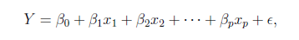
The linear combination equation captures information
outcome
coefficients
constant
Error or residuals (noise)
Informative features or “predictors”
The combinations of beta coefficients seeks to minimize the squared errors between the actual Y values and the equation. This combination manifests as the “best fit line”

Slide 32
#
= $6$ + 0.$25$*temperature + $3$*satudray_dummy + -0.5*price
Beta-Naught | Temperature | Satuday_dummy | Price
6 | 0.25 * 80 degrees | 3 * 1 | -0.5 * 5
5 | 0.25 * 88 | 3 * 0 | -0.5 * 2

Slide 33
#
= $6$ + 0.$25$*temperature + $3$*satudray_dummy + -0.5*price
Best Fit Prediction | Beta-Naught | Temperature | Satuday_dummy | Price
26.5 | 6 | 20 | 3 | -2.5
27 | 6 | 22 | 0 | -1

Slide 34
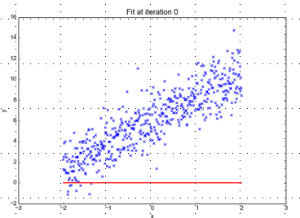
Minimizing the Sum of Ordinary Least Squared Errors
Equation:
Y= 0 +(0*x)
Beta “Naught” = 0
Intercept is 0
X beta coefficient = 0
No slope
Blue points Y Values represent actual outcome.
MINUS
Red line is the predicted outcome
Equals the Error

Slide 35
Big Errors
Equation:
Y= 0 +(0*x)
Beta “Naught” = 0
Intercept is 0
X beta coefficient = 0
No slope
Blue points Y Values represent actual outcome.
MINUS
Red line is the predicted outcome
Equals the Error

Slide 36
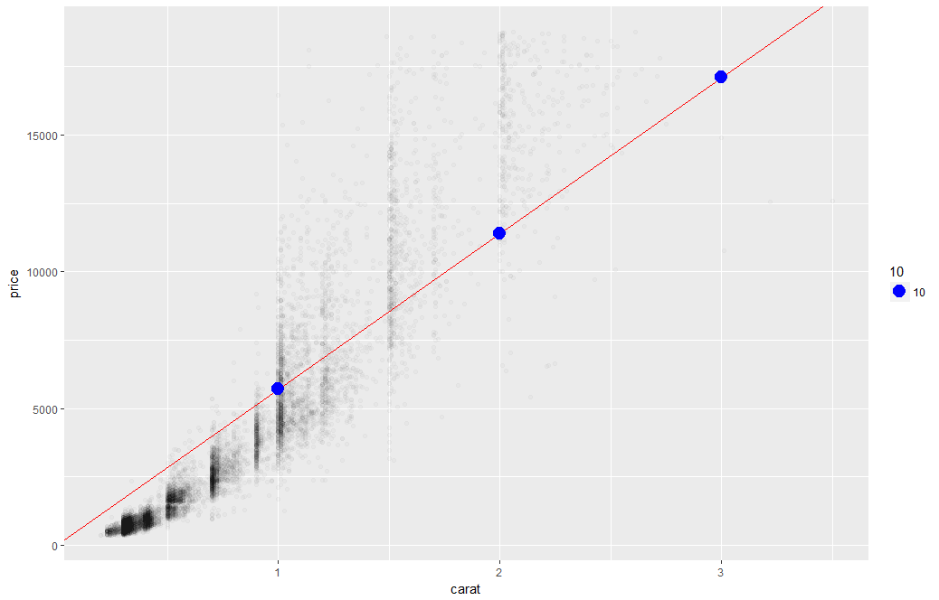
What’s really going on?
Errors between a prediction and actual.
Notice some are negative and some are positive

Slide 37
Why Least Squared Error?
Blue points Y Values represent actual outcome.
MINUS
Red line is the predicted outcome
Equals the Error
Cones
85
48
45
27
32
30
69
80
15
61
Prediction
67
42
54
95
1
48
51
95
20
22
Error
18
6
-9
-68
31
-18
18
-15
-5
39
-3
(18 + 6 + -9 + -68 + 31 + -18 + 18 + -15 + -5 + 39)
Squaring the error means all errors have the same impact on the optimization function.
Notes:
Is this a good model?
18 + -18 cancel each other out

Slide 38
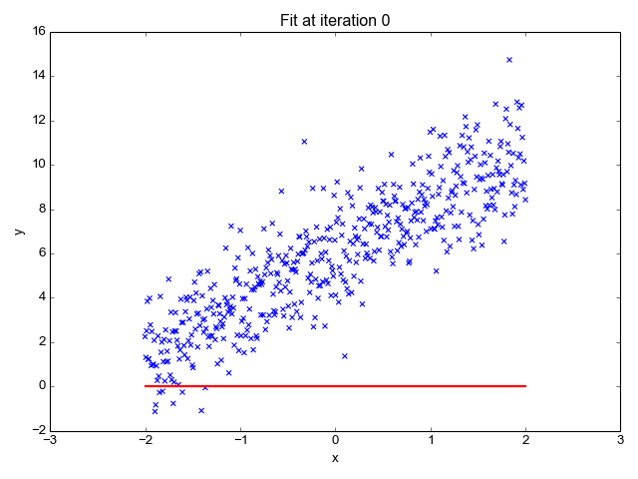
So what is really going on?
The algorithm is optimizing the inputs and weights (beta’s) to minimize the sum of squared errors.
This is called “ordinary least squares (OLS).

Slide 39
Let’s Practice
Open C_Regression_v1.R

Slide 40

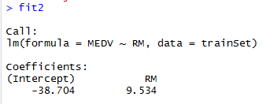
Explanatory Vs Predictive
Reviewing beta coefficients can explain relationships
There is a positive relationship between number of rooms and housing prices.
Holding all other inputs constant the median price would increase 9.534 for each room.
In contrast what would the relationship be for crime? Positive or Negative?
Notes:
Fancy way of saying reviewing identical houses but with 1 bedroom and 2.

Slide 41
Agenda
Start | End | Item
 |  | Regression in Action
 |  | Partitioning Data
 |  | Understanding Regression (simple univariate)
 |  | Build & Evaluate a Multiple Linear Regression
 |  | Logistic Regression for Classification

Slide 42
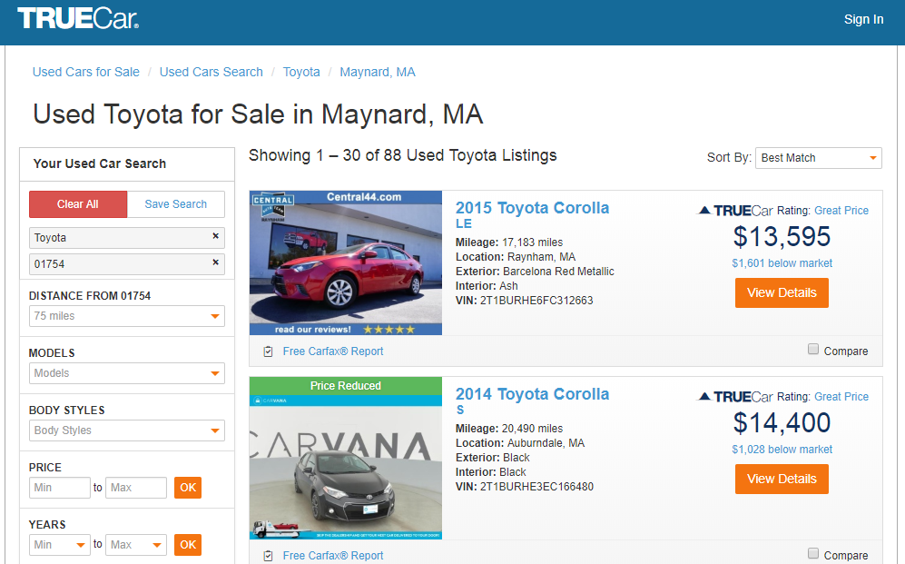
How does truecar.com know the price is “great?”

Slide 43

Yeah! I got a new job!

Slide 44
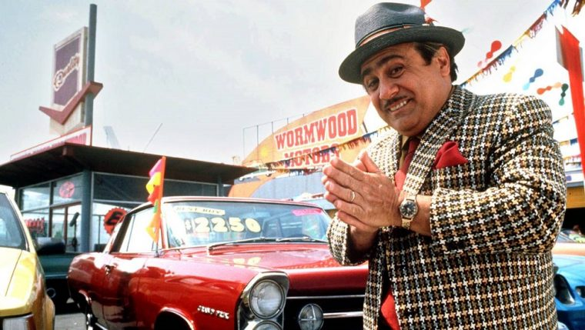
Welcome Dale to TrueCar’s Competitor: OldCar
Dale, can you predict used car prices? Then we will know if a car is priced above/below expected value

Slide 45

Let’s help Dale again.
But of course. This sounds like a predictive modeling project.

Slide 46
Let’s practice.
Open D_oldCar.R
Price in Euros
Tires binary 0/1 are new tires on car
Age in months as of 8/04
KM (kilometers)
Fuel Type (diesel, petrol, CNG)
HP (horsepower)
Metallic color (1=yes, 0=no)
Automatic transmission (1=yes, 0=no)
CC (cylinder volume)
Doors
Quarterly_Tax (road tax)
Weight (in kg)
Using the preprocessing and partitioning code in your toolbox, create a linear model of Toyota prices.

Slide 47

Regression is susceptible to multi-colinearity
Math
The presence of two or more predictor variables sharing the same linear relationship with the outcome variable.
Don’t shock the cat by having multi-collinearity.
In other words
Two+ informative features are measuring essentially the same thing.
Example
When predicting ice cream sales you include Fahrenheit and Celsius temperatures as two separate informative features.

Slide 48

Regression is susceptible to multi-colinearity
What happens with multi-collinearity?
The effect is exaggerated e.g. double counted.
The good news
The problem is so prevalent/impactful that R’s linear regression function handles it.
Other algorithms are not affected by double counting
Best Practice
Even though R removes it, do not rely on the function. Understanding the data you put in will avoid “garbage in, garbage out” scenarios.
Make happy cats by
knowing your data.

Slide 49
Back to R, script D!

Slide 50
Agenda
Start | End | Item
 |  | Regression in Action
 |  | Partitioning Data
 |  | Understanding Regression (simple univariate)
 |  | Build & Evaluate a Multiple Linear Regression
 |  | Logistic Regression for Classification

Slide 51
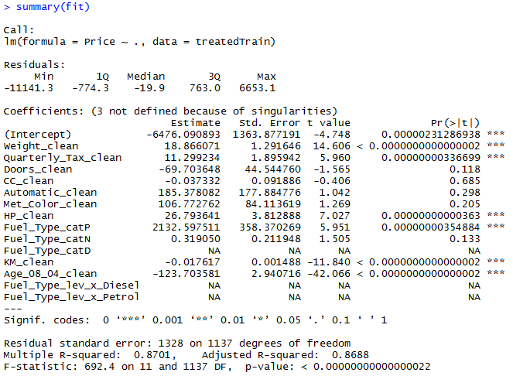
The Summary of the Fit
Auto ID of multi colinearity

Slide 52
The Summary of the Fit
Summary stats for the errors.

Slide 53
The Summary of the Fit
Treated Variable Names i.e. informative features

Slide 54
The Summary of the Fit
Coefficients or Beta values

Slide 55
The Summary of the Fit
P-Values
Small p-values mean the coefficient impact is less likely due to be chance.
In stats <.05
In reality <0.2
What variables should we drop with a p-value >=0.2?

Slide 56
Back to the script D

Slide 57
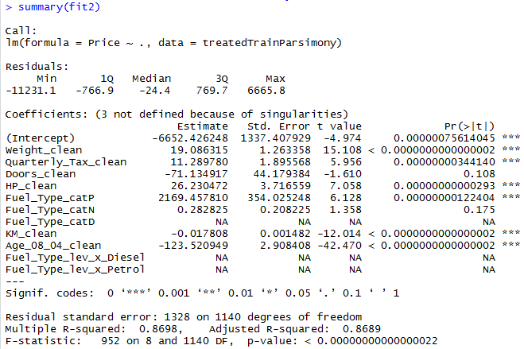
Parsimonious Model
Parsimony or compactness is desirable in models. The more features in a model, the more complexity we introduce, data integrity, data interactions, time to score and time to predict are all impacted.
Notes:
We could drop yet another engineered variable but let’s continue. P =.175

Slide 58
Parsimonious Model
R-Sq: how much of the variation are the model is fitting. R-Sq measures the linear relationship between Price & features It always lies between 0 and 1
Notes:
We could drop yet another engineered variable but let’s continue.

Slide 59
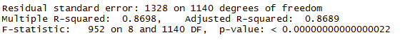
Compare the two models
fit1
fit2
It can be said that both models explain ~87% of the variation in car prices. Dropping the variables improved accuracy and reinforces the fact that the variables didn’t add value.

Slide 60
Evaluating a Prediction Model
RMSE- Root Mean Squared Error
MAPE- Mean Absolute Percentage Error
y
y-hat
Actual Values | Predicted/Forecasted
10 | 6
12 | 8
20 | 18
36 | 20
Besides P-Values which is a variable level KPI, and adjusted R-Sq there are two popular KPI for evaluating continuous model predictions.

Slide 61
RMSE
RMSE- Root Mean Squared Error
Actual Values | Predicted/Forecasted | Errors | Squared Errors
10 | 16 | -6 | 36
12 | 8 | 4 | 16
20 | 17 | 3 | 9
36 | 34 | 2 | 4
Mean
36+16+9+4
4
To manually calculate RMSE, work the acronym backwards.

Slide 62
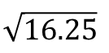
RMSE
RMSE- Root Mean Squared Error
Actual Values | Predicted/Forecasted | Errors | Squared Errors
10 | 16 | -6 | 36
12 | 8 | 4 | 16
20 | 17 | 3 | 9
36 | 34 | 2 | 4
Mean
Square Root
36+16+9+4
$$\sqrt{16.25}$$
4
=4.03
In the same units being measured, tells you +/- the prediction error.

Slide 63
MAPE
MAPE- Mean Absolute Percentage Error
Actual Values | Predicted/Forecasted | Errors | Absolute | As % of Forecast
10 | 16 | -6 | 6 | =6/16 or 37%
12 | 8 | 4 | 4 | =4/8 or 50%
20 | 17 | 3 | 3 | =3/17 or 17%
36 | 34 | 2 | 2 | =2/34 or 5%
Mean of Percentages
37%+50%+17%+5%
4
=27.7%
Instead of squaring error, take the absolute error. Then divide that by the actual value. Lastly calculate a mean average of all the percentage errors.

Slide 64

Back to script D
How good is Dale’s model?
Notes:
For the predict warning about rank deficient matrices:
Rank of the matrix is reduced since it throws out multi-collinear variables. Often can be safely ignored.

Slide 65
Agenda
Start | End | Item
 |  | Regression in Action
 |  | Partitioning Data
 |  | Understanding Regression (simple univariate)
 |  | Build & Evaluate a Multiple Linear Regression
 |  | Logistic Regression for Classification

Slide 66
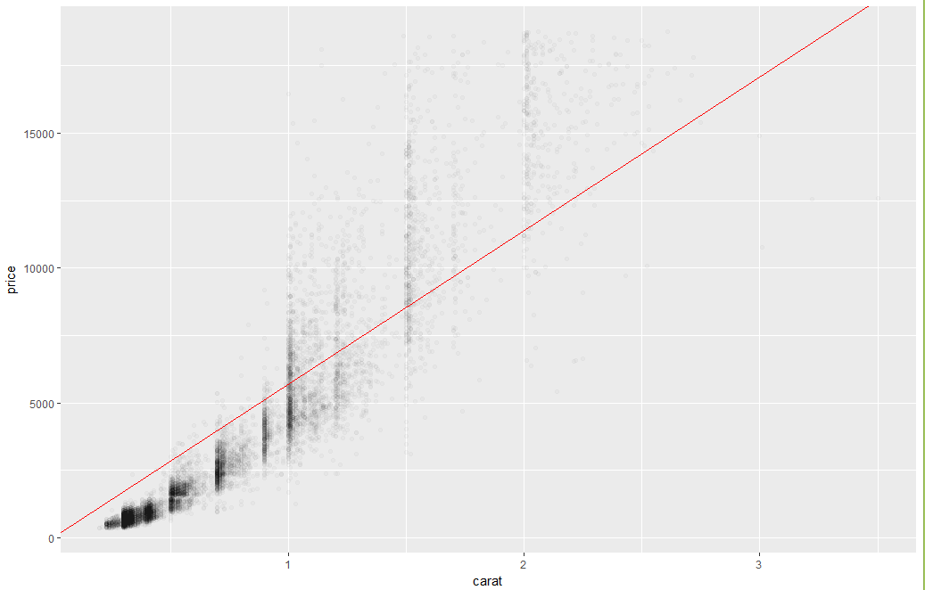
Regression Vs Logistic Regression
Notes:
How does this answer a Y/N question?
Can anyone recognize a problem applying regression to a binary classification?

Slide 67
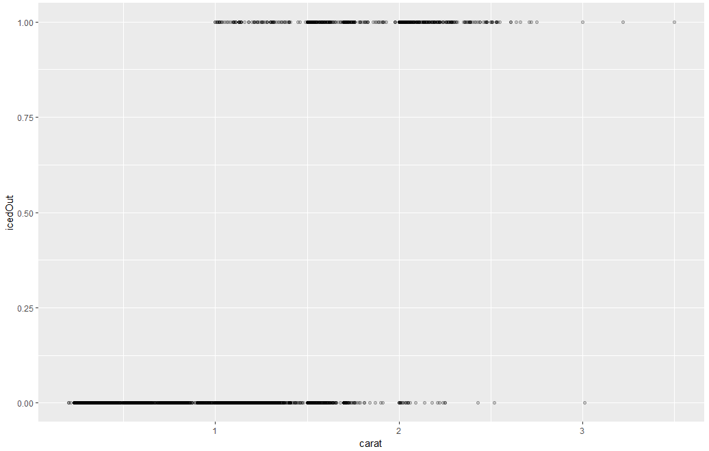
Binary (Price >$11K = 1)

Slide 68
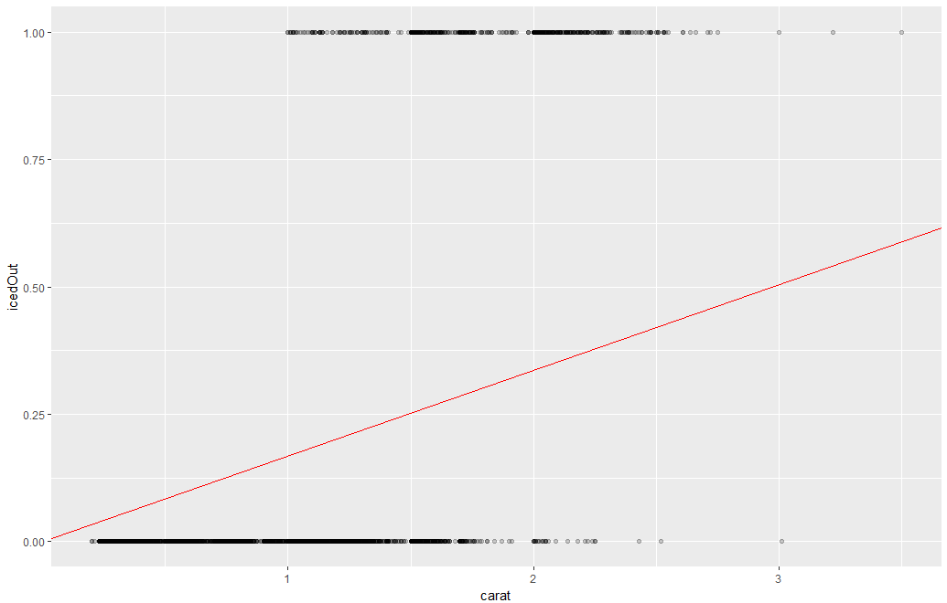
Huh?

Slide 69
Let’s find out firsthand.
Open E_lm_for classes.R
For expediency we will not run this in class but you may want to as review of the preceding slides.

Slide 70
Logistic Regression
Extends idea of linear regression to situation where outcome variable is categorical
Instead of ordinary least squares, β are derived through an iterative process called maximum likelihood estimation
We focus on binary classification
i.e. Y=0 or Y=1

Slide 71
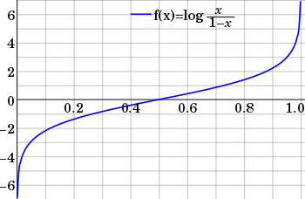
The Logit
Goal: Find a function of the predictor variables that relates them to a 0/1 outcome
Instead of Y as outcome variable (like in linear regression), we use a function of Y called the logit
Logit can be modeled as a linear function of the predictors
The logit can be mapped back to a probability, which, in turn, can be mapped to a class
This is a continuous outcome but has little change as it approaches -1 & 1.

Slide 72
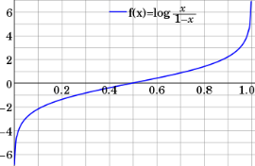
Step 1: Logistic Response Function
Regression
How Many Cones?
#
= $β$ + $β$*temperature + $β$*day + $β$*price + error
Logistic Regression
Will they buy a cone Y/N?
Logit of
= $β$ + $β$*temperature + $β$*day + $β$*price + error
We will let R handle calculating the equation output logOdds to the more understandable probability.

Slide 73

NCAA Classification Madness
College Basketball
Annual 64 team tournament
Business Impact:
$1B wagered
$2B in lost productivity
Bragging Rights
Objective: Identify the probability of a team winning in Round 1.

Slide 74

My friend Mandy is next level.
https://fivethirtyeight.com/features/how-a-data-scientist-whod-never-heard-of-basketball-mastered-march-madness/

Slide 75
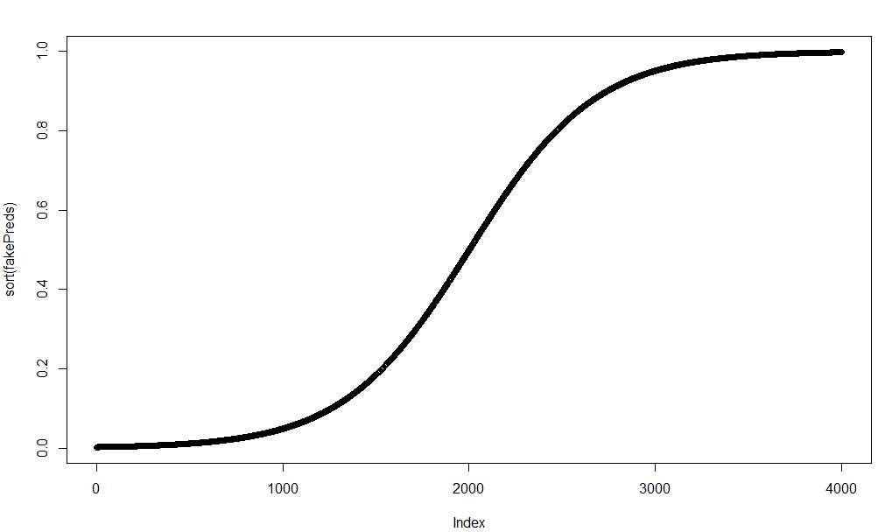
Probabilities approach 0 and 1
Sorted probabilities for avg blocks across a wide spectrum -100 to 100 create an infinite curve of probabilities.

Slide 76
From probability to class, define a cutoff threshold.
0.50 is popular initial choice
Additional considerations (see Chapter 5)
Maximize classification accuracy
Maximize sensitivity (subject to min. level of specificity)
Minimize false positives (subject to max. false negative rate)
Minimize expected cost of misclassification (need to specify costs)
If a team has a probability of .25 classify them as a loser.
If a team has .50 or more classify them as a winner

Slide 77
Let’s practice
Open G_fullyMarchMadnessREVISED.R
We skip over the “F” Rscript which builds a single variable logistic regression.

Slide 78
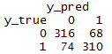
Evaluating a Classification
Confusion Matrix
The model predicted losers 390 (316 + 74) times
The model was correct 316 times for losers
The model predicted 378 winners (68+310)
The model was correct 310 times for winners

Slide 79
Logistic Regression Summary
Logistic regression is similar to linear regression, except that it is used with a categorical response
The predictors are related to the response Y via a nonlinear function called the logit
As in linear regression, reducing predictors can be done via variable selection
Logistic regression can be generalized to more than two classes

Slide 80
Agenda
Start | End | Item
 |  | Regression in Action
 |  | Partitioning Data
 |  | Understanding Regression (simple univariate)
 |  | Build & Evaluate a Multiple Linear Regression
 |  | Logistic Regression for Classification

Slide 81


Your Data Mining Toolbox
Previous Lessons
Some R Programming
Knowledge of Data Preparation
Exploratory Data Analysis
Basic Visualization
After today
You can answer Yes/No Business Questions
You can predict continuous business outcomes
Regression & Logistic Regression are two good starting algorithms . Both put you on a path to more complex machine learning but more importantly you can start to frame business problems in terms algorithms can understand.

